Slide 1
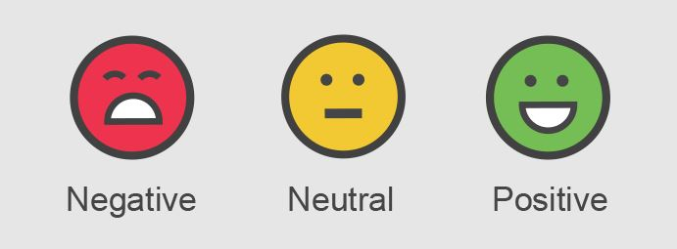
SENTIMENT ANALYSIS OF M-PESA MOBILE MONEY SERVICE USING TWITTER DATA
GROUP 3

Slide 2






OUR TEAM
Eva Gitau
Eric Cheruiyot
Colletta Nandutu
Lisa Kagendo
Samwel Omondi
Miriam Wangari

Slide 3
INTRODUCTION
Sentiment analysis is a technique used to determine and categorize an opinion about a product, service or idea as positive, negative or neutral. Sentiment analysis helps organizations gather insights from unorganized and unstructured text that comes from online sources such as emails, blog posts or social media channels.
It is often performed to help businesses monitor brand and product sentiment in customer feedback and understand customer needs.
This project aim is to analyze and accurately predict a tweet's sentiment about M-pesa services in Kenya so as to understand the general public opinion and make improvements on the products and quality of service.

Slide 4
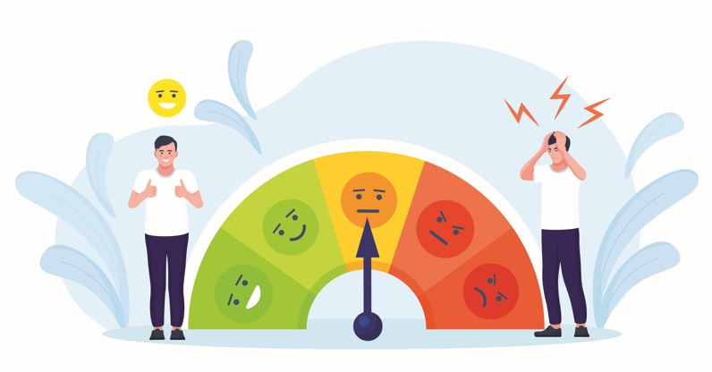
Research Question
What are the sentiments expressed in tweets about M-pesa services and can we predict them accurately?

Slide 5
Research Objective
Main Objective
To understand customers' satisfaction with Mpesa products and services and gauge whether a tweet's sentiment is neutral, positive or negative in order to improve the quality of service.
Specific Objectives
To gauge public opinion on M-pesa so as to assess m-pesa brand reputation.
To identify potential causes for positive or negative sentiment towards M-pesa.
To identify the most common topics and hashtags related to M-pesa.
To identify the most common sentiment related to m-pesa.
To predict a tweet's sentiment on m-pesa accurately.

Slide 6
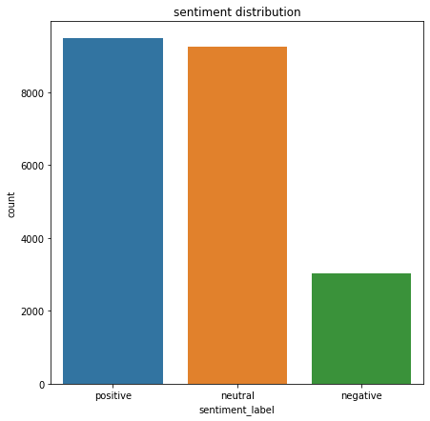
Distribution of Customers Sentiments

Slide 7
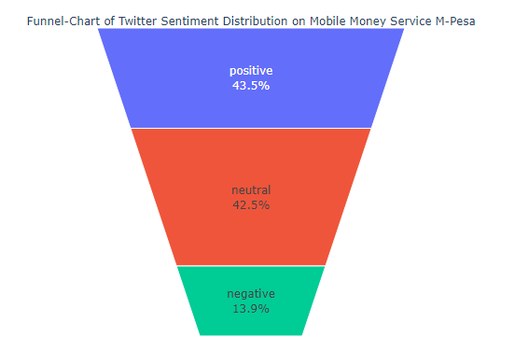
Funnel-Chart of Mpesa Sentiment Distribution

Slide 8
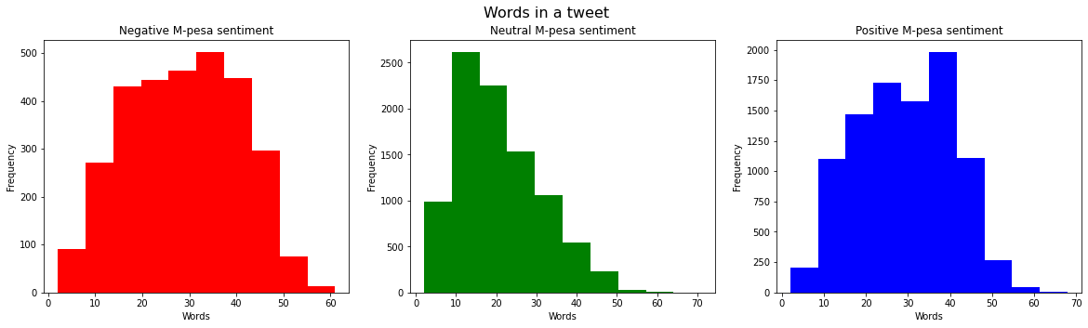
Distributions of Number of Words in Tweets

Slide 9
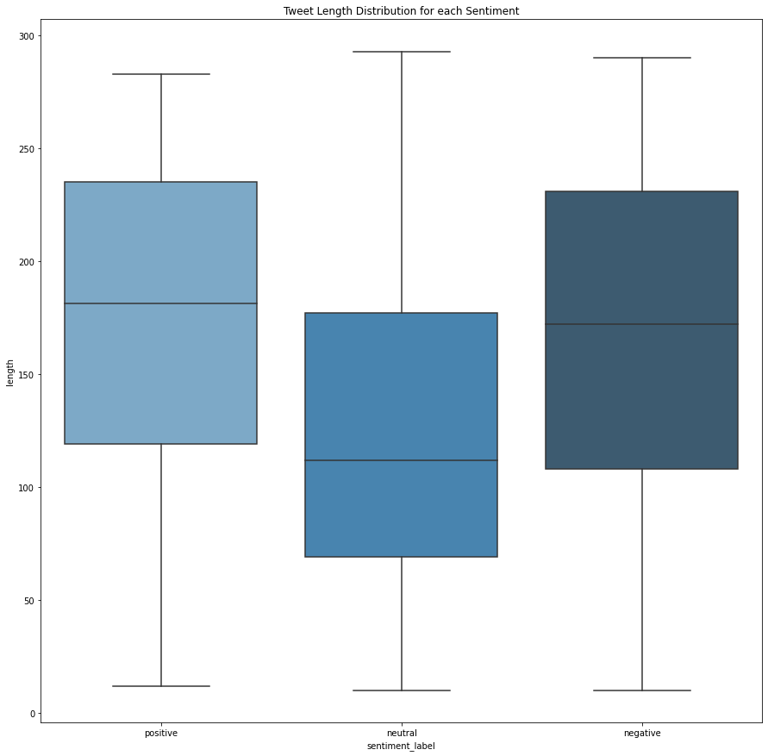
Boxplot for Average Length of Tweets for Each Sentiment

Slide 10
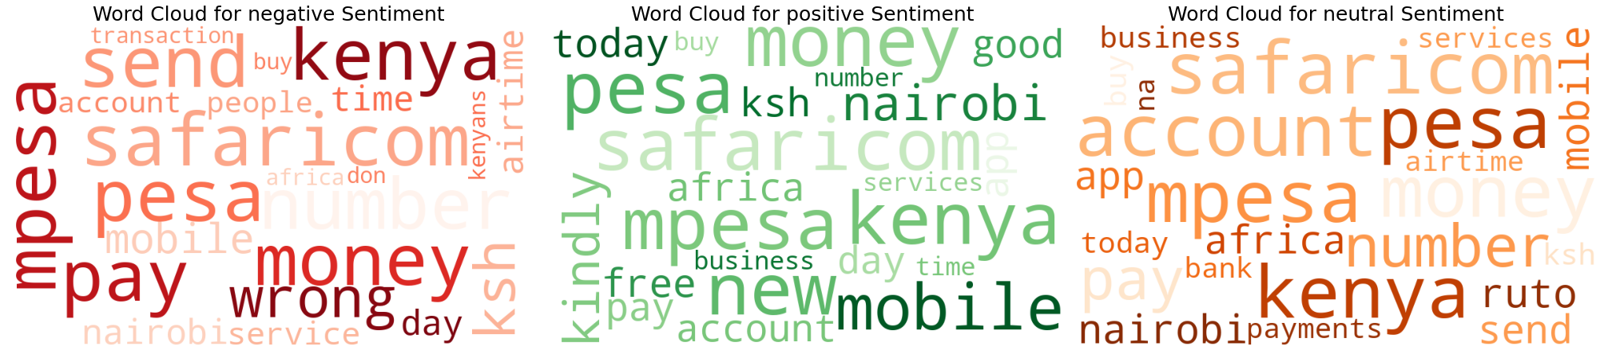
Word Cloud for Word Frequency in the Sentiments

Slide 11
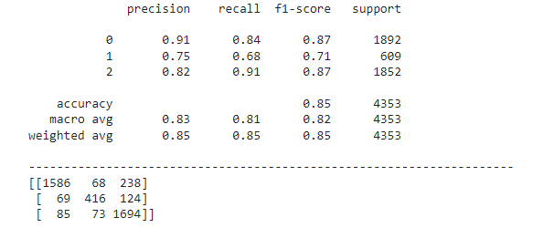
Findings
The model performed fairly well with a precision of 91% and an accuracy of 85%
The total number of correctly predicted sentiments are
  Neutral - 1586 out of 1892
  Negative - 416 out of 609
  Positive - 1694 out of 1852

Slide 12
CONCLUSIONS
Most tweets are positive sentiments on mobile money m-pesa services at 43.5%, closely followed by tweets which are neutral at 42.5% and the last are tweets which have negative sentiments on m-pesa services at 13.9%.
COVID-19 had a positive impact on M-Pesa transactions due to the removal of transaction fees during the pandemic.
Users tweet frequently about the transactions that ended up in money being sent to wrong numbers and these tweets are mainly negative sentiment-wise.
Users tweet frequently about the Fuliza overdraft service, and it features quite negatively though popular.
The most popular hashtags related to M-Pesa are mpesa, safaricom and Kenya.

Slide 13
RECOMMENDATIONS
M-Pesa could leverage the positive impact of COVID-19 on its public image by the removal or reduction of transaction fees which attracted positive public sentiment during the pandemic.
Since the Fuliza overdraft service is frequently mentioned in negative sentiment tweets, M-Pesa and NCBA bank could work on improving the service to increase customer satisfaction.
M-Pesa could analyze tweets related to "wrong" number transactions and work on improving the user experience to reduce negative sentiment. This can be done by ensuring the users can verify the correct number to transact with and facilitating easier reversal of erroneous transactions for better user satisfaction.

Slide 14

THANK YOU!
Do you have any Questions?

